Slide 1
Start the app
Select source dataset
Upload a gpkg
Define classification per disturbance types
Use demo dataset
Select attributes that describe:
Linear disturbance industries
Linear disturbance types
Areal disturbance industries
Areal disturbance types
Add other disturbances
Select buffer size
Select overall buffers on:
Set linear buffer size (m)
Set areal buffer size (m)
Use custom buffers
Set minimum intact patch size (km²)
Include mining claims
Include fires
Include other disturbances
Yes
Yes
Yes
Set mine claims buffer size (m)
No
Set minimum fire size
No
No
Set buffer size (m)
Generate undisturbed areas
Save layers in GeoPackage

Slide 2
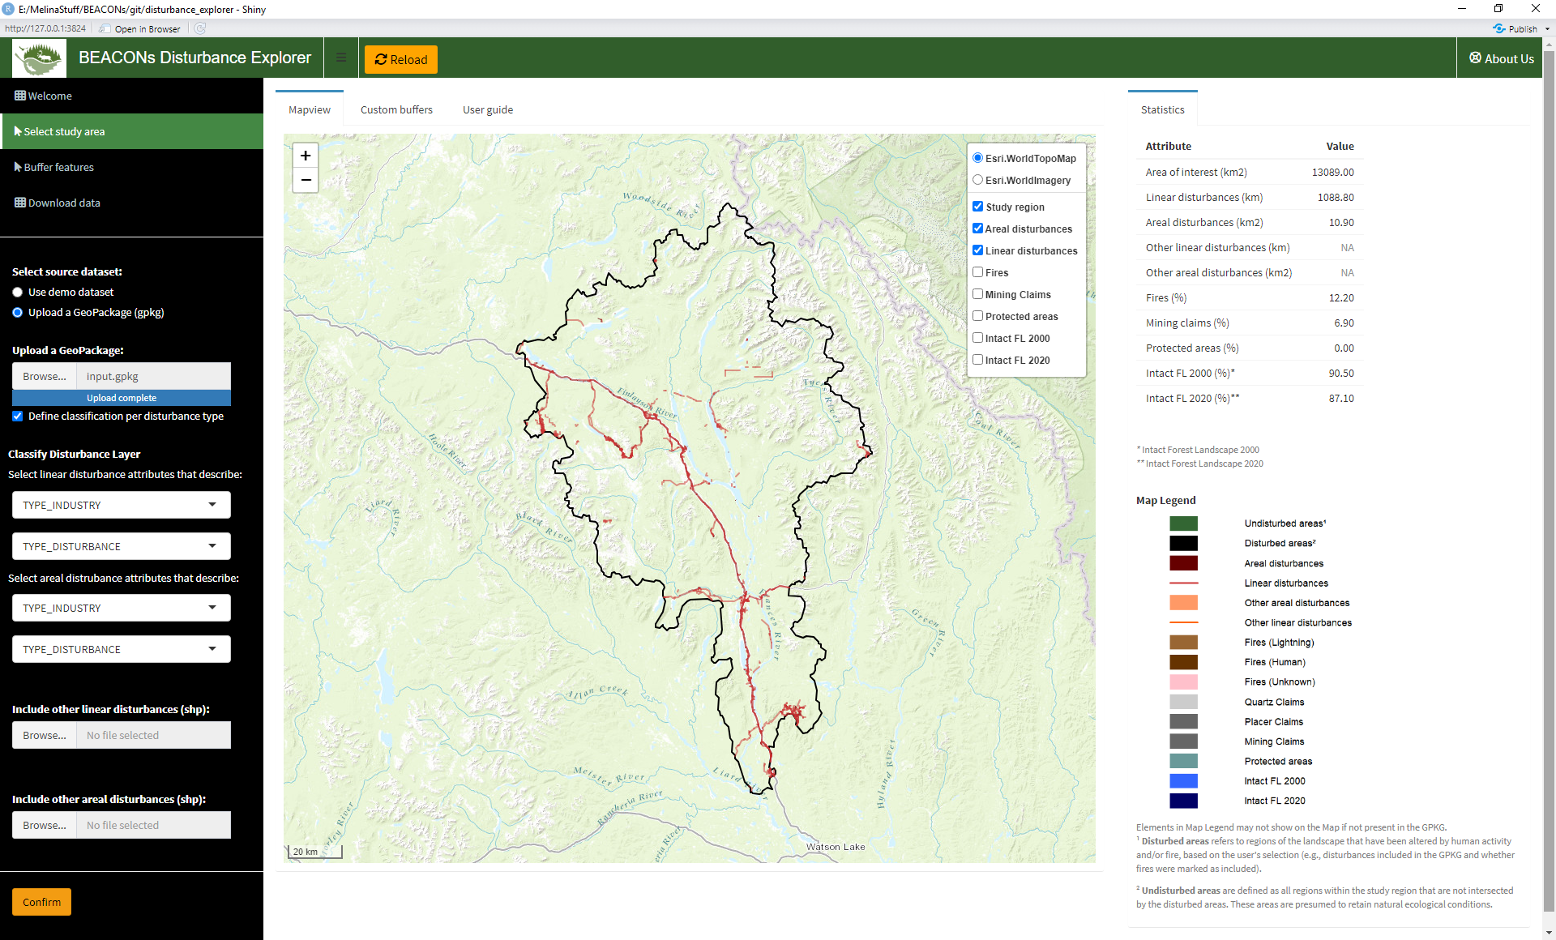
Notes:
SelectSA

Slide 3
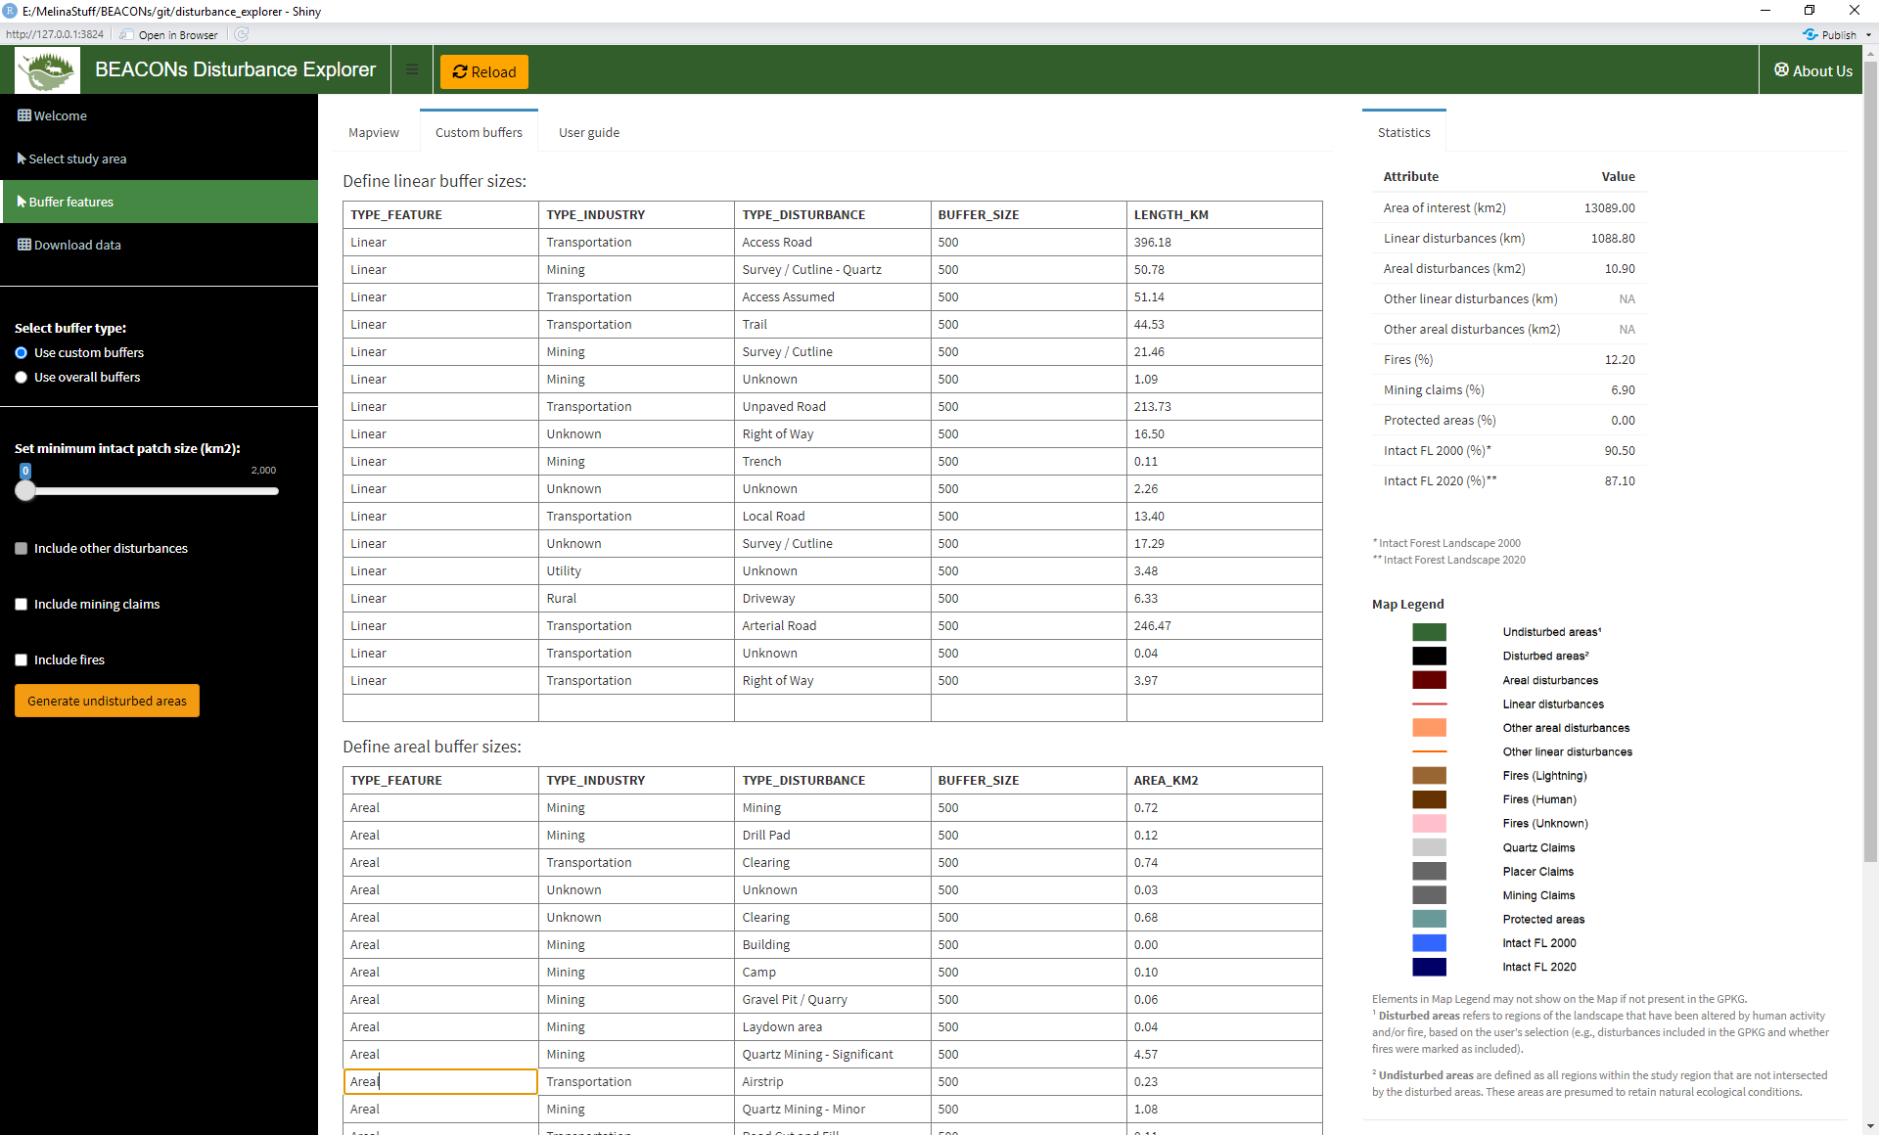
Notes:
customBuffer

Slide 4
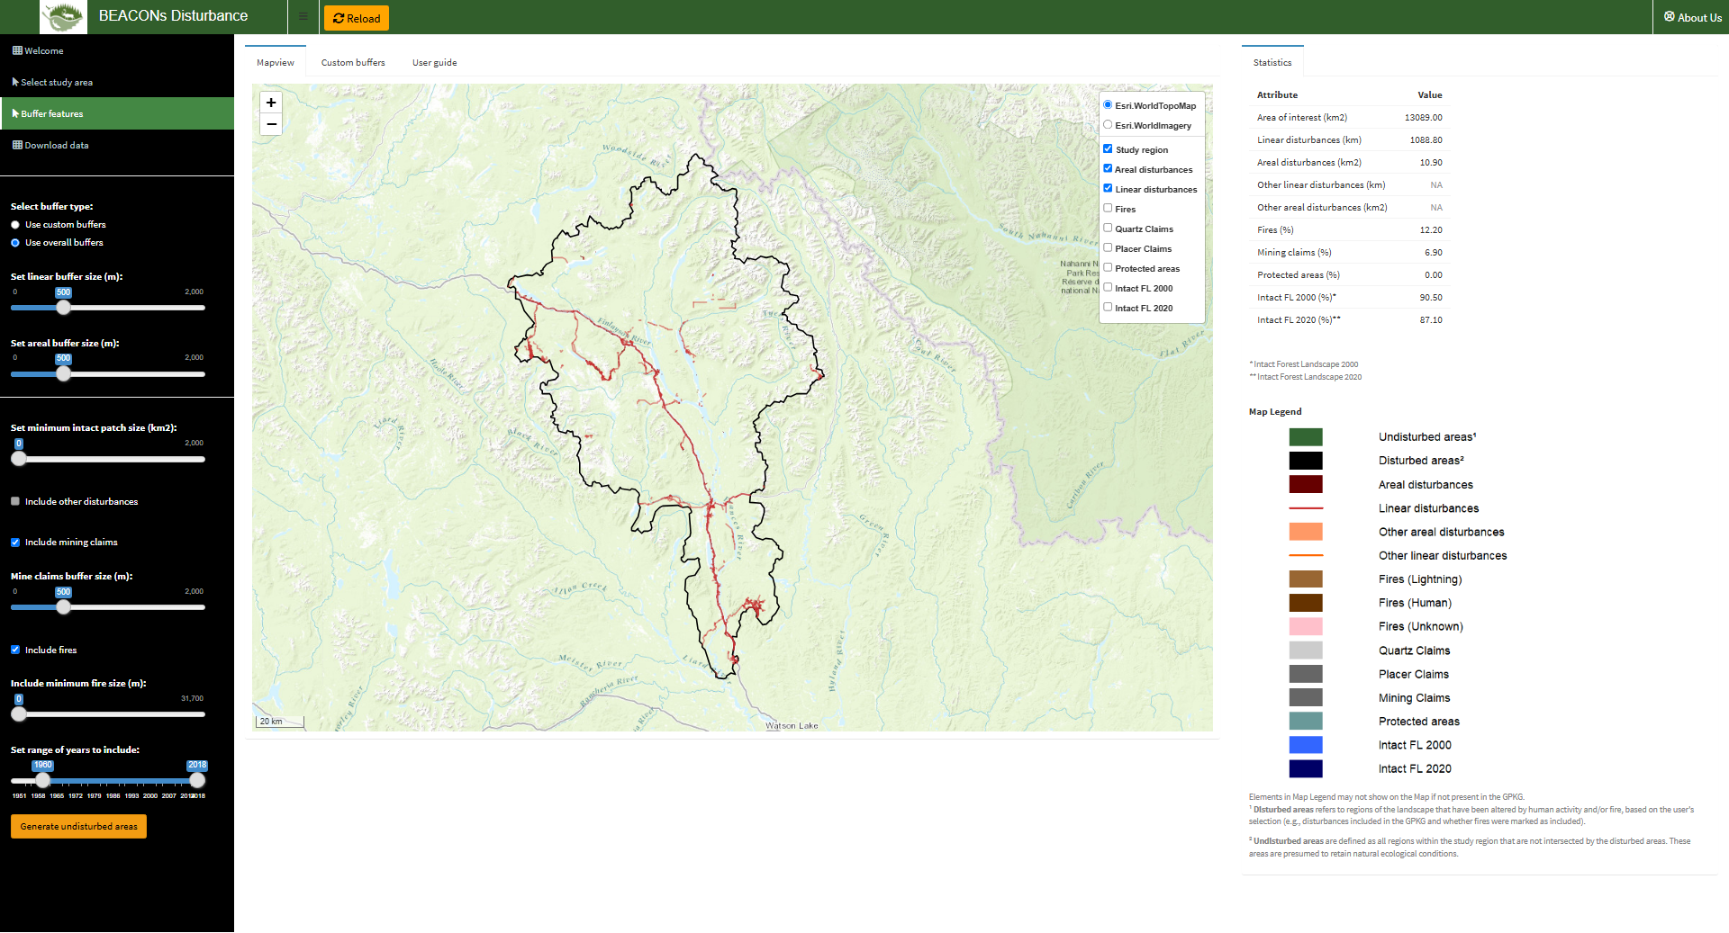
Notes:
setOptions

Slide 5
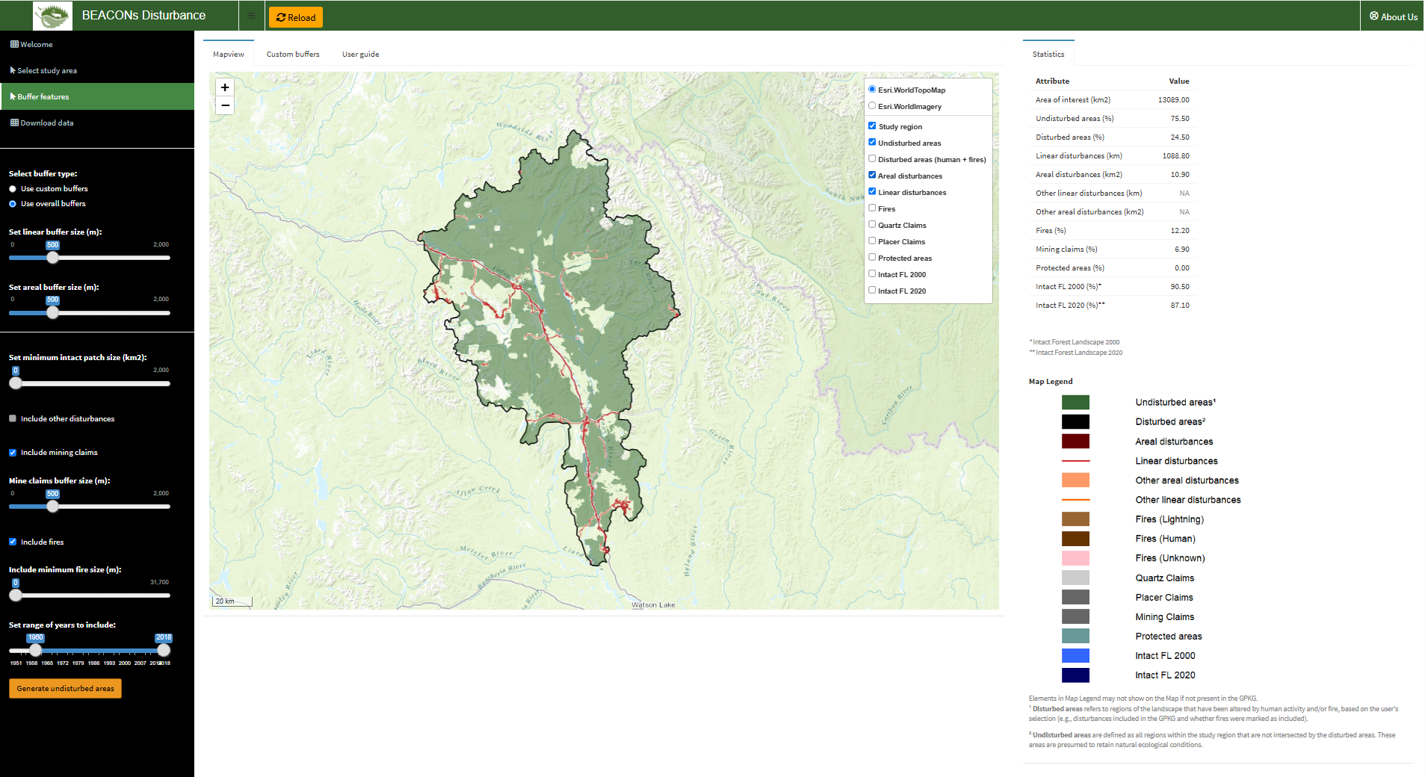
Notes:
mapping

Slide 6
Notes:
stats

Slide 7
